Slide 1

GESTURE OF AQUA TECH
Ministry: Ministry of Jal Shakti
PS Code: 1293
Problem Statement Title: Automatic regulations of valves for release of water.
Team Name: Loop Escaper’s
Team Leader Name: Abhijeet Swami
Institute Code (AISHE) :
Institute Name: Aravali college of Engineering and Management.
Theme Name: Agriculture, FoodTech & Rural Development

Slide 2
OUR TEAM
Team Leader: Abhijeet Swami
Branch: B.Tech Stream: CSE(AIML) Year: III
Team Member: Priyanshu Choubey
Branch: B.Tech Stream: CSE (AIML) Year: III
Team Member: Ayush Kumar
Branch: B.Tech Stream: CSE (AIML) Year: III
Team Member: Priya Jha
Branch: B.Tech Stream: CSE (AIML) Year: III
Team Member: Rishika Mishra
Branch: B.Tech Stream: CSE Year: III

Slide 3
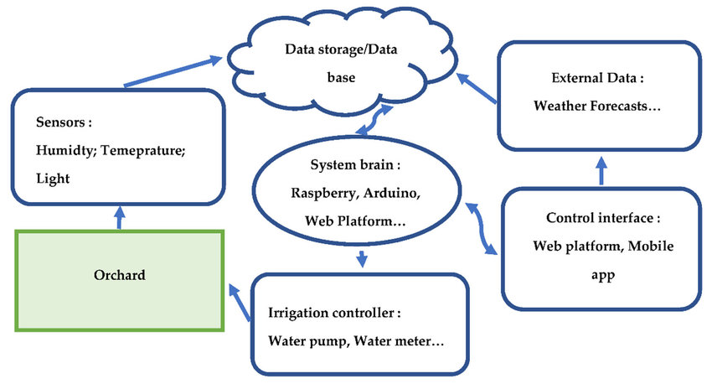
PROBLEM STATEMENT
Automatic regulation of valves for release of water based upon soil moisture availability in the root zone of the crop, using artificial intelligence, in a piped and micro irrigation network of irrigation system.
Lack the precision required to deliver water tailored to the actual needs of crops, leading to water wastage.
The main problem is the smart system or Automation is missing .
The core issue is the absence of Data Analytics and AI .
The inconsistency in Water Quantity Monitoring , and Remote Control or Monitoring .

Slide 4
SOLUTION IRRIGATION MANAGEMENT
Please ensure below pointers to get the solution for automatic irrigation system:
To Address this problem, there is need for Plant Integrated sensors and Quantum Computing of irrigation specialization .
It leverages AI to enable the automation of valves for water release in different type of irrigation networks.
We use the divergent sensors that monitors the soil Different properties like Ph , Moisture , Humidity and analyze the atmosphere Condition .
It Send the weather data or soil moisture data to determine the irrigation need of plants and Crops .

Slide 5
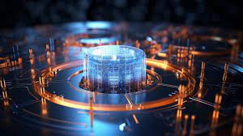
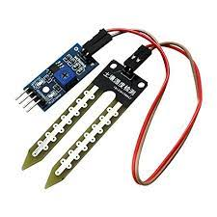
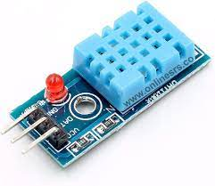
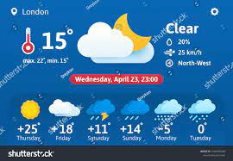
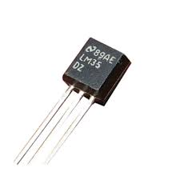
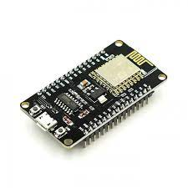
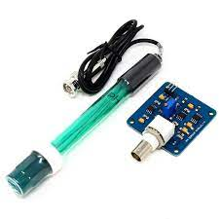
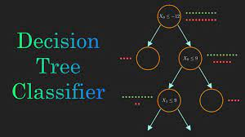
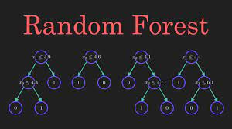
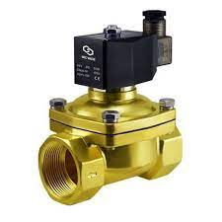
SENSORS &Technique
Sensor ‘s →
Humidity Sensor :
Moisture Sensor :
Temperature Sensor :
WIFI Module ESP-32 :
pH Sensor :
Solenoid Valve :
Technique ‘s →
Data Visualization and :
storage
Weather Analysis :
AI Model ‘s :

Slide 6
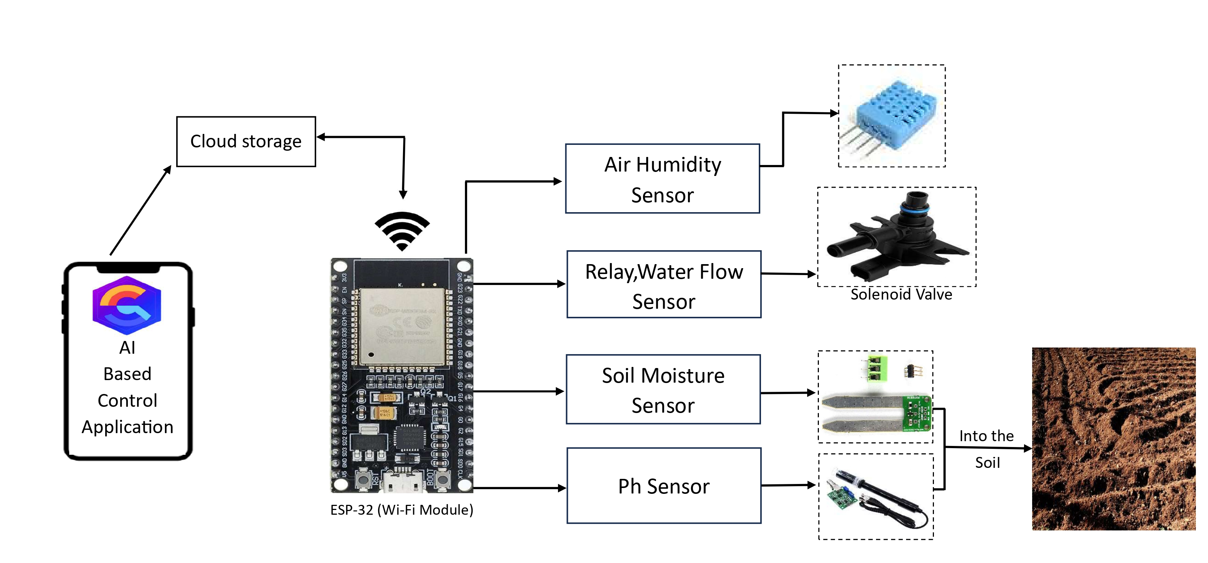
IMPLEMENTATION
This system is developed to eliminate the problem of an Irrigation System:
For Automatic mechanism of Irrigation System, We use the divergent sensors for sensing the need or requirement of water to the crops .
Moisture Sensor, Humidity Sensor, pH sensor, Temperature Sensor
A Software to manage the implementation of the automatic irrigation system.

Slide 7
AUTOMATIC IRRIGATION SYSTEM
MERITS :
DEMERITS:
Water conservation: It can optimize water usage by applying only the amount needed by crop.
Increased crop yields: It can ensure that crops always receive the right amount of water, leading to higher.
Reduce Labor cost: It can help to reduce labor costs by automating the irrigation system.
Environmental Sustainability: It can help to improve environmental sustainability by reducing water pollution and runoff.
Data Storage : The Data analytics and storage of data should be incomplete .
Complexity: It can be complex for the uneducated farmers .
Lack of skilled labor: There may be a shortage of skilled labor who can install and maintain automatic irrigation systems.

Slide 8
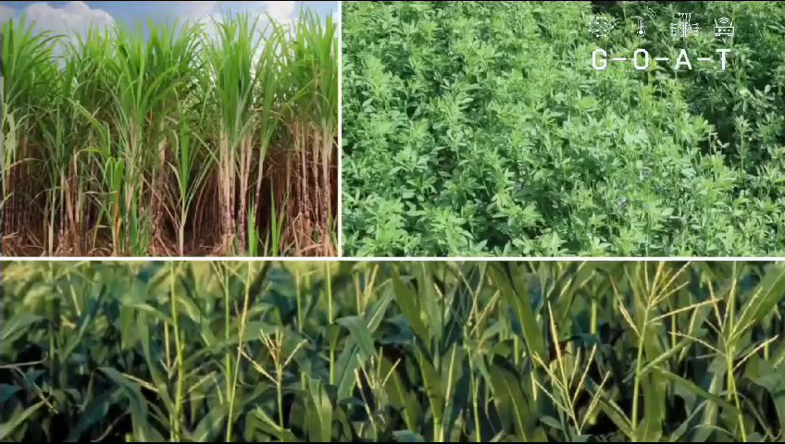

Slide 9
THANK YOU
“GESTURE OF AQUA TECH”

